Slide 1

The food club

Slide 2
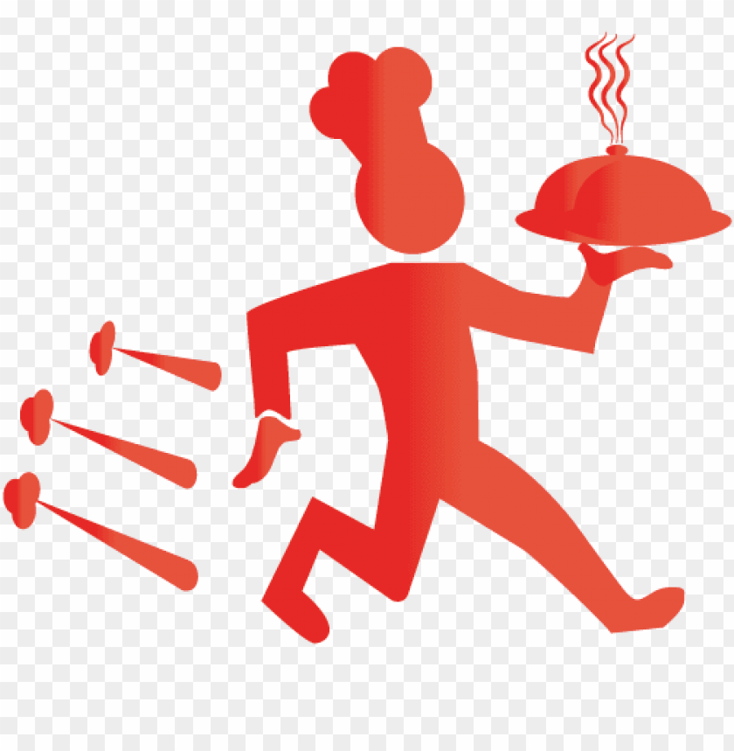
Introduction
Welcome to the food club restaurant.
This is one of the classy restaurants that always offers fresh and tasty food.
It has managed to attract more customers because of our dedicated chefs.
We also have online menus that helps us to avoid covid-19 and being close to one another.
The picture below simply shows that our customers comes first.

Slide 3
The Body Thiis is one of a kind menu that helps us increase transaction amounts and being on top of current trends.
Since our menu is online I have learned that it brings us more customer because they recognise that we also put their safety first.
This restaurants websites is one of a kind because it safe and quick to everyone and you are allowed to make changes whenever.
This menu has created a good target audience, and it has made everyones life easy.
The pictures bellows are the most amazing dishes that we have and more and we sometimes even have specials once a month.
The brightness and presentation of our food is the one that is attracting more people, and as well a well organized online menu

Slide 4
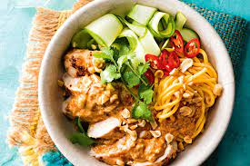
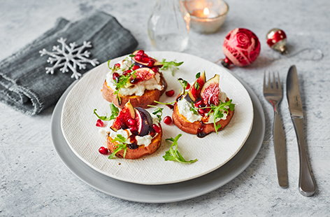
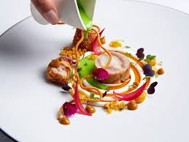
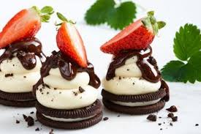
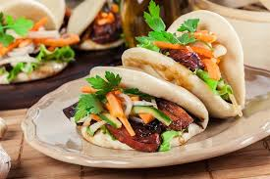

Slide 5

This graph above simply shows that there has been some growth in our country, because now we live a digital world, where everything is now online. They is growth within our company meaning we are winning as online restaurants.
IN CONCLUSION
All in all every company needs to start being online to increase their market tools and also reduce costly errors in that way you would receive more orders than you used to, and your business will be well known and always active in any cicumstance.

Slide 6
REFERENCES
https://www.upmenu.com>blog>9.
hhtps;//en.m.Wikipedia.org>wiki
https://www.investopidia.org
Miranda.l(2016)the benefit of online restaurants.hhtps://doi.org.com

